Slide 1
Introduction to Java Programming
Object Oriented Programming
AAPP013-4-2
Copyright 2016 Asia Pacific Institute of Information Technology

Slide 2
Topic & Structure of the lesson
What is Java ?
Java and The Internet
How Java differs from the C language
Applets and Applications
The Java Development Kit (JDK)
A Simple Java Program
API documentation
Notes:
<number>

Slide 3
Learning Outcomes
At the end of this topic, you should be able to:
Explain what Java means
List the differences between Java and C
Explain the differences between an applet and an application
Explain the definition of the various Java commands listed in the JDK
Write simple Java programs
Notes:
<number>

Slide 4
Key Terms you must be able to use
If you have mastered this topic, you should be able to use the following terms correctly in your assignments and exams:
Application - A complete, self-contained program that performs a specific function directly for the user.
Applet - A Java program which can be distributed as an attachment in a World-Wide Web document and executed by a Java-enabled web browser.
Notes:
<number>

Slide 5
Key Terms you must be able to use
If you have mastered this topic, you should be able to use the following terms correctly in your assignments and exams:
Platform - the hardware / software environment in which a program runs.
Java platform - a software-only platform that runs on top of other, hardware-based platforms.
Notes:
<number>

Slide 6
Key Terms you must be able to use
Java Virtual Machine (Java VM)
A virtual CPU including instruction set, register set, class file format, stack, garbage collected memory heap & memory area
Every Java interpreter, whether it’s a Java development tool or a Web browser that can run Java applets is an implementation of Java VM.
Notes:
<number>

Slide 7
Key Terms you must be able to use
Java Application Programming Interface (Java API)
A large collection of ready-made software components that provide many useful capabilities such as graphical user interface (GUI) widgets.
The Java API is grouped into libraries (packages) of related components
Notes:
<number>

Slide 8
What is Java?
Let us examine what Java is in terms of
Language comparison
Platform independence
Language features
Notes:
<number>

Slide 9
What is Java?
Language comparison
SmallTalk C++
First true OO Language. Powerful systems language.
Secure type-checking. Familiar to many programmers.
JAVA
( Combines the best of both, leaving out the difficulties)
Notes:
<number>

Slide 10
What is Java?
Language features
Java is a High-Level Programming Language that is :
Simple
- powerful functionality without the confusing features(eg. pointers)
- reduce 50 % of the bugs
Objected oriented
- implements the basic object technology of C++ with enhancement
Distributed
- built-in extensive TCP/IP networking capabilities
Notes:
<number>

Slide 11
What is Java?
Language features
Java is a High-Level Programming Language that is :
Robust
- check for problems at compile and run-time - help catch the bugs at the early stage of development
- handles own memory - no worries on freeing & corrupting memory
- reduce development time
Secure
- Java codes passes several tests before executing on machine
- eg. Byte-code verifier, class loader
Notes:
<number>

Slide 12
What is Java?
Language features
Java is a High-Level Programming Language that is :
Multithreaded
- threads - light-weighted processes
- allows many simultaneous activities in 1 program
- better interactive performance and real-time behaviour
Portable
- basic portability of being architecture neutral / independent
- Java builds its user interfaces via an abstract window system so the windows can be implemented on UNIX, PC & MAC environments
Notes:
<number>

Slide 13
What is Java?
Language features
Java is a High-Level Programming Language that is :
Architecture Neutral (Special Feature)
both compiled and interpreted
with compiler, a Java program is translated into Java bytecodes
with interpreter,each Java bytecode instruction is parsed and run on computers
Notes:
<number>

Slide 14
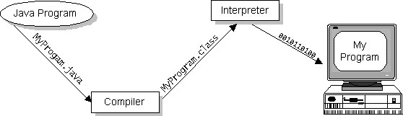
What is Java?
Architecture Neutral (Special Feature)
Java Bytecodes - machine code instructions for the Java Virtual Machine (Java VM).
Notes:
<number>

Slide 15
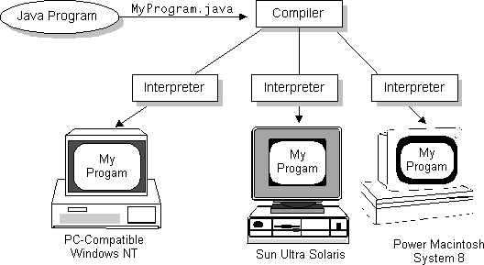
What is Java?
Architectural Neutral
+
Portable (abstract window)
”Write Once, Run Anywhere - Platform Independent”
Notes:
<number>

Slide 16

What is Java?
Platform - the hardware / software environment in which a program runs.
Java platform - a software-only platform that runs on top of other, hardware-based platforms.
The Java platform has 2 components :
The Java Virtual Machine (Java VM)
The Java Application Programming Interface (Java API)
Notes:
<number>

Slide 17
What is Java?
Java Virtual Machine (Java VM)
A virtual CPU including instruction set, register set, class file format, stack, garbage collected memory heap & memory area
Every Java interpreter, whether it’s a Java development tool or a Web browser that can run Java applets is an implementation of Java VM.
Notes:
<number>

Slide 18
What is Java?
Java Application Programming Interface (Java API)
A large collection of ready-made software components that provide many useful capabilities such as graphical user interface (GUI) widgets.
The Java API is grouped into libraries (packages) of related components
Notes:
<number>

Slide 19
Quick Review Question
Name 2 OOP languages
Is Java a language or a platform?
Give 3 features of the Java Programming language
Is a Java program compiled or interpreted?
What is the JVM
How does Java achieve platform independence?
Notes:
<number>

Slide 20
Java and The Internet
Java is becoming a computing platform-base for software developers to build applications
these applications can execute on any computing platform
a variety of applications can be built eg. critical applications used by big companies, accounting, asset management, databases, human resources and sales
Notes:
<number>

Slide 21
How Java differs from C
No preprocessor Java does not require constructs such as #define, #include, and #ifdef
JAVA uses 16-bit Unicode characters compatible with ASCII and to the ISO8859-1 (Latin-1) characters
No pointers referencing and dereferencing of objects are handled automatically by JAVA
Notes:
<number>

Slide 22
How Java differs from C
No multiple inheritances JAVA does not support multiple inheritances, features of multiple inheritance are supported in the form of interfaces
Garbage Collection in C you need to make explicit calls to malloc() to allocate memory. Use free() to deallocate memory. In Java, there is a new keyword, but no delete. Objects are implicitly deleted when they go out of scope or are no longer needed.
Note : There are many more differences between JAVA and C
Notes:
<number>

Slide 23
Quick Review Question
List the 5 differences between Java and C/C++
Which of these differences are between C and Java?
Which are between C++ and Java?
Notes:
<number>

Slide 24
Applets and Applcations
The most common types of Java programs are :
Applets
- A Java program that adheres to certain conventions that allow it to run within a Java-enabled web browser.
Applications
- A standalone Java program that runs directly on a java platform.
- As Java is a general purpose, high-level programming
language and a powerful software platform, we can write many types of programs.
Notes:
<number>

Slide 25
The Java Development Kit (JDK)
The JDK contains what one needs to start building and executing JAVA applications and applets.
Notes:
<number>

Slide 26
The Java Development Kit (JDK)
Here is how you can set up and program in Java
Download the Java Development Kit (JDK) http://www.oracle.com/technetwork/java/javase/downloads/index.html
Notes:
<number>

Slide 27
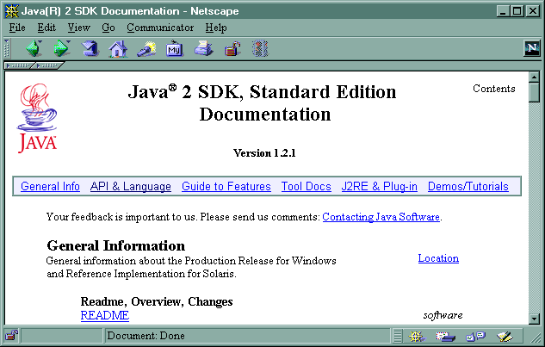
The Java Development Kit (JDK)
The JAVA API documentation is the standard on-line help for the JAVA platform. You will get most of what you need from this API (online : http://docs.oracle.com/javase/8/docs/api/).
Notes:
<number>

Slide 28
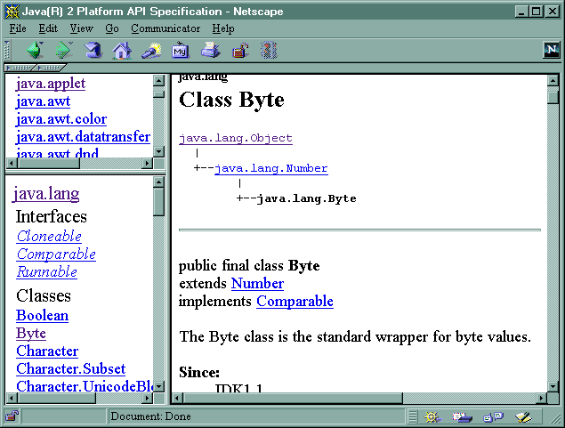
The Java Development Kit (JDK)
Packages
Detail of Classes/ Interfaces
- Methods /Variables
Classes/ Interfaces
Notes:
<number>

Slide 29
Quick Review Question
Here are a couple quick questions before we plunge into our
first Java program.
What is the difference between an applet and an application?
Does an application need the JVM for execution?
Does an applet need the JVM for execution?
Does a browser need the JVM for executing Java applets?
How does the JVM get embedded/installed in a browser
or CPU?
Notes:
<number>

Slide 30
A simple Java program
1. Create a Java Source File
Using a text editor (eg. Notepad), create a file named
HelloWorldApp.java with the following Java code:
Notes:
<number>

Slide 31
A simple Java program
/*Sample_01
* The HelloWorldApp class implements an application
* that simply displays "Hello World!" to the standard
* output.
*/
class HelloWorldApp {
public static void main(String[] args) {
System.out.println("Hello World!"); //Display the string.
}
}
Notes:
<number>

Slide 32
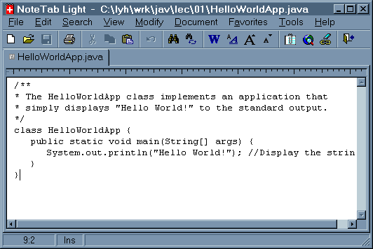
A simple Java program
If you use the NoteTab Light editor to type Java
programs, here is how it looks like;
Notes:
<number>

Slide 33
A simple Java program
2. Compile the Source File
Compile the source file using the Java compiler like this;
javac HelloWorldApp.java
Notes:
<number>

Slide 34
A simple Java program
If the compilation succeeds, the compiler creates a file named HelloWorldApp.class in the same directory (folder) as the Java source file (HelloWorldApp.java). This class file contains Java bytecodes, which are platform-independent codes interpreted by the Java runtime system.
If the compilation fails, make sure you typed in and named the program exactly as shown above, using the capitalization shown. If you can't find the problem, Compiler Problems might be able to help you.
Notes:
<number>

Slide 35
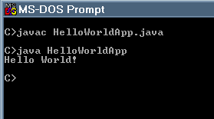
A simple Java program
3. Run The Application
Run the application using the command like this;
java HelloWorldApp
Notes:
<number>

Slide 36
Follow Up Assignment
Using any text editor, write a Java application that display the message
Surely the best Java programmers come from Java!
Test your application
Show your app on the board at the beginning of the next lesson
Notes:
<number>

Slide 37
Summary of Main Teaching Points
What is Java?
Language comparison
Platform independence
Language features
Simple, secure, muti-threaded, …
Java and The Internet
Computing platform base, …
How Java differs from the C language
No pointers, no multiple inheritence (C++), …
Notes:
<number>

Slide 38
Summary of Main Teaching Points
Applets and Applications
The Java Development Kit (JDK)
A Simple Java Program
API documentation
Notes:
<number>

Slide 39
Learning Outcomes
At the end of this topic, you should be able to:
Explain what Java means
List the differences between Java and C
Explain the differences between an applet and an application
Explain the definition of the various Java commands listed in the JDK
Write simple Java programs
Notes:
<number>

Slide 40
Question and Answer Session
Q & A

Slide 41
Next Session
Overview of
Identifiers
Data types
Operators
Expressions
Notes:
<number>

